Slide 1
Ebay Website - Testing
Under Guidance oF Mrs. Vaishali sonanis maam

Slide 2
Introduction
eBay is a global e-commerce website, which connects millions of buyers and sellers worldwide.
This website allows users to buy, sell, variety of products.
This project’s purpose is to test the eBay website using automation testing.

Slide 3
Overview
In this eBay website testing project, I have tested most important features of the eBay website which can have severe impact on website if these features don’t perform as expected.
Did automation testing on eBay website using Selenium WebDriver and TestNG framework.
Used Page Object Model for better code readability and code reusability.

Slide 4
Modules
Module 1 : Login Page
Checked all the functionalities on Sign in page which included username/email field, continue button, password field and another continue button.
Also checked that only for valid credentials only user is able to login else give error message.

Slide 5
Module 2 : Search Box
Checked all the functionalities on Search box by entering combination of characters and combination of characters and numbers and verifying that the results are as expected.
Also given inputs using array to make the searching of items faster.

Slide 6
Module 3 : Add To Cart
Checked all the functionalities of add to cart button by clicking on the product and clicking on add to cart button.
Verifying that item is added to the cart.
Used getWindowHandle() to handle the new window so that it does not break the execution of the program.

Slide 7
Module 4 : Remove Item from Cart
Checked all the functionalities on remove from cart by clicking on the cart icon on the top and then clicking on remove button to remove item from cart
Verifying that item is removed from the cart.
It’s mandatory to have item in the cart to remove any item.
So there is dependency of addtocart() method for remove_cart() method to execute.

Slide 8
Module 5 : Shop By Category
Checked functionality of shop by category which includes dropdown and selecting of any category and checking the redirection.

Slide 9
Module 6 : Right Click
Checked the functionality of right click by searching item in the search box and then right clicking on the particular product.
Used Actions class to use contextClick(right click).perform() to perform the right click operation.

Slide 10
Module 7 : Shop By All Category
Checked functionality of shop by all category which includes dropdown and selecting of any category and checking the redirection.

Slide 11
Module 8 : Change Language
Checked functionality of change language by moving cursor on USA flag and then clicking on the country flag of the language user want to choose.
Verifying language is changed.
Used Actions class to perform moveToElement().perform() to move cursor on USA flag.

Slide 12
Defects
No proper language change option is present, user needs to change the country to change language and there are no local languages.

Slide 13
Defect identifier :- B_001
Defect summary :- No proper language change option is there.
Ø Test Id :- TC_001
Ø Test case name :- TC_change_lang
Ø Module name :- Language Change
Ø Reproducible :-
Ø Severity :- medium
Ø Priority :- medium
Ø Raised by :- Prathamesh Sangale
Ø Assigned to :- developer Team lead
Ø Date of assignment :- 18/08/2025
Ø Status :- pending
Ø Snap shots :-
Ø Fixed by :- developer
Ø Date of fixing :- 19/08/2025

Slide 14
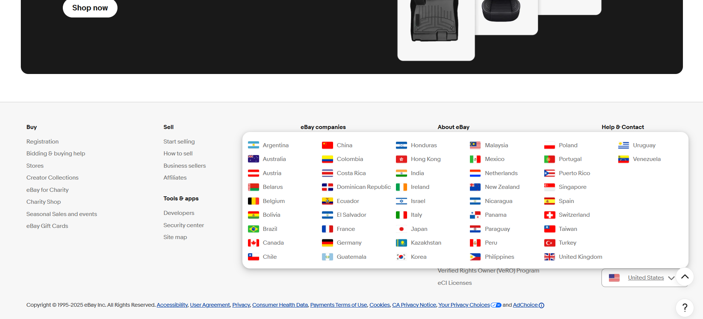

Slide 15
Defect identifier :- B_002
Defect summary :- language change option not present other than home page, user need to go to home page to change language
Ø Test Id :- TC_002
Ø Test case name :- TC_change_lang_not_available
Ø Module name :- Language Change
Ø Reproducible :-
Ø Severity :- low
Ø Priority :- medium
Ø Raised by :- Prathamesh Sangale
Ø Assigned to :- developer Team lead
Ø Date of assignment :- 18/08/2025
Ø Status :- pending
Ø Snap shots :-
Ø Fixed by :- developer
Ø Date of fixing :- 19/08/2025

Slide 16
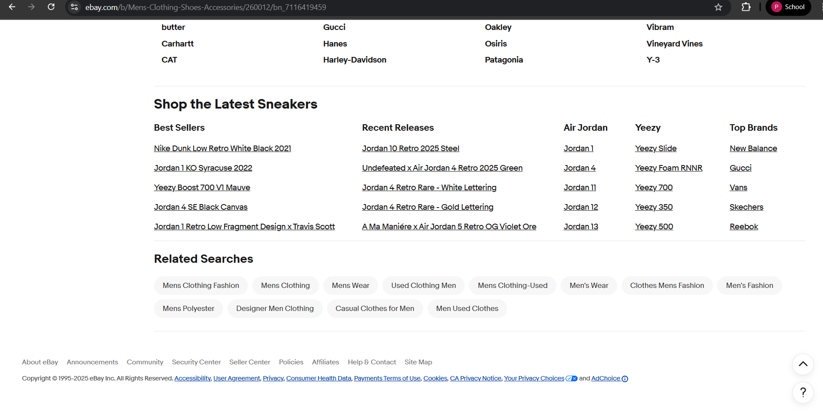

Slide 17
Challenges
While testing eBay website, following are some of the challenges I faced:
Using annotations for the first time.
Not able to recall all the driver methods.
Confusion which locator to use when 2 unique locators are available.
Implementing all the written test cases into actual code for some of the modules.

Slide 18
Experience
Learned and got hands on experience on the real website.
Understood the importance of practical knowledge by implementing the theoretical knowledge into actual coding
Got understanding of tools like Selenium WebDriver and TestNG framework.

Slide 19
Thank You!!!

